Slide 1


Social Buzz : Data Analysis Report

Slide 2


Today's agenda
Project recap
Problem
The Analytics team
Process
Insights
Summary

Slide 3

Social Buzz is a fast growing Social Media Company. It needs to quickly adapt to its global scale.
Accenture has begun a 3 month Project with them to accomplish the 3 tasks:
- An audit of their big data practice
- Recommendations for a successful IPO
- An analysis of their content categories that highlights the top 5 categories with the largest aggregate popularity
Project Recap

Slide 4


Problem
100000 pieces of content each day
That makes it
36500000 content a year.
How to capitalize on it?
Analysis to find Social Buzz’s top 5 content categories.

Slide 5



The Analytics team

Slide 6
Process
1
Data Understanding
2
Data Cleaning
3
Data Modeling
4
Data Analysis
5
Uncover Insights

Slide 7
Data Cleaning
Sheet name | Data Issue | Action taken
Content | Inconsistency in Category names(had "") | Find and Replace formula to remove quotation marks
Content | Extra column user-id | not needed column removed by deletion
Content | Ambiguous column name "Type" | Renamed to "Content Type" to remove ambiguity
Reactions | Blanks in column "Reaction type" | Deletion of blanks after filtering
Reactions | "Type" ambiguous column | Renamed column to "Reaction type" to remove ambiguity
Reaction Types | "Type" ambiguous column | Renamed column to "Reaction type" to remove ambiguity

Slide 8

Insights
Total no. of Reactions to ‘Animals’ Category
1897
Month with Highest posts
May
No. of Unique Categories
16

Slide 9
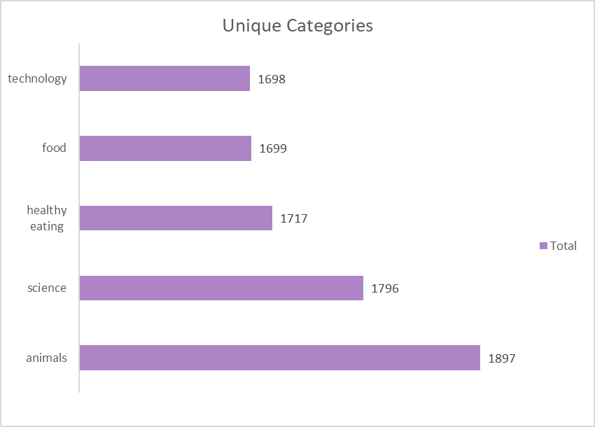
Top 5 Most popular Content Categories

Slide 10
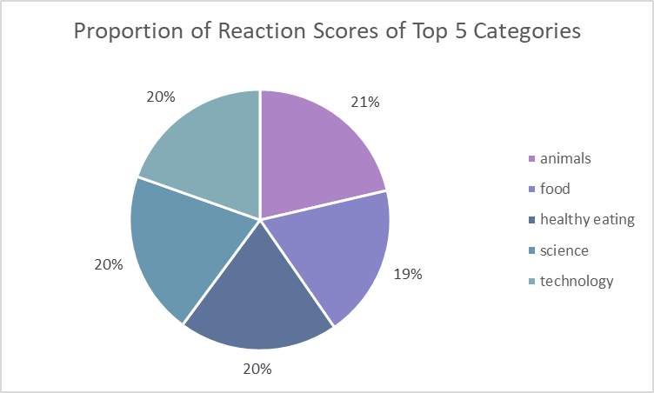
Top 5 Categories Proportion of Content Scores

Slide 11
Top 5 Categories and their Total Reaction Scores
Top 5 categories | Reaction Types
Category | adore | cherish | disgust | dislike | hate | heart | indifferent | interested | intrigued | like | love | peeking | scared | super love | want | worried
animals | 114 | 125 | 122 | 115 | 128 | 120 | 100 | 110 | 116 | 101 | 119 | 129 | 132 | 123 | 122 | 121
food | 93 | 119 | 107 | 106 | 130 | 107 | 97 | 108 | 94 | 100 | 123 | 115 | 101 | 89 | 110 | 100
healthy eating | 122 | 105 | 103 | 101 | 121 | 114 | 108 | 101 | 107 | 106 | 103 | 104 | 100 | 116 | 111 | 95
science | 118 | 103 | 114 | 113 | 102 | 115 | 122 | 118 | 111 | 113 | 119 | 112 | 102 | 92 | 126 | 116
technology | 129 | 114 | 110 | 95 | 112 | 114 | 98 | 121 | 87 | 87 | 96 | 116 | 88 | 113 | 113 | 105

Slide 12
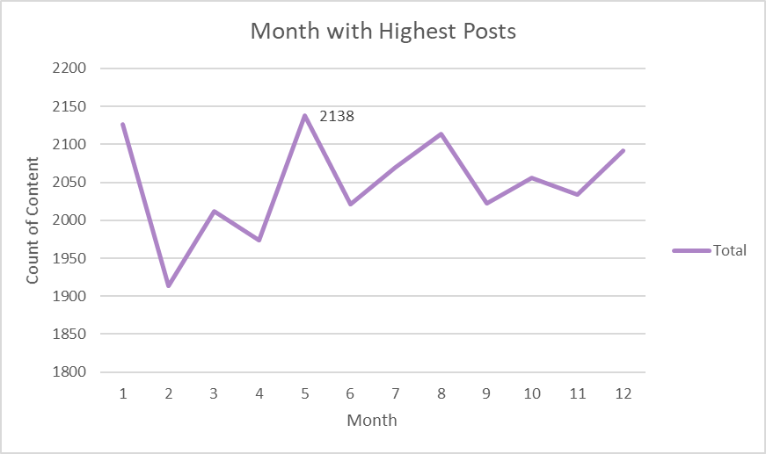
Month with Highest Posts

Slide 13

Top 5 Content Categories
Animals
Science
Healthy eating
Food
Technology
Month with highest Posts
May
Analysis is limited because of size of sample provided. A larger dataset would provide more insights.
Summary

Slide 14

Thank you!
ANY QUESTIONS?

